Slide 1
March 9, 2021
Kagukar Studie
Buddie
Victor Olateju|victorolateju8@gmail.com

Slide 2
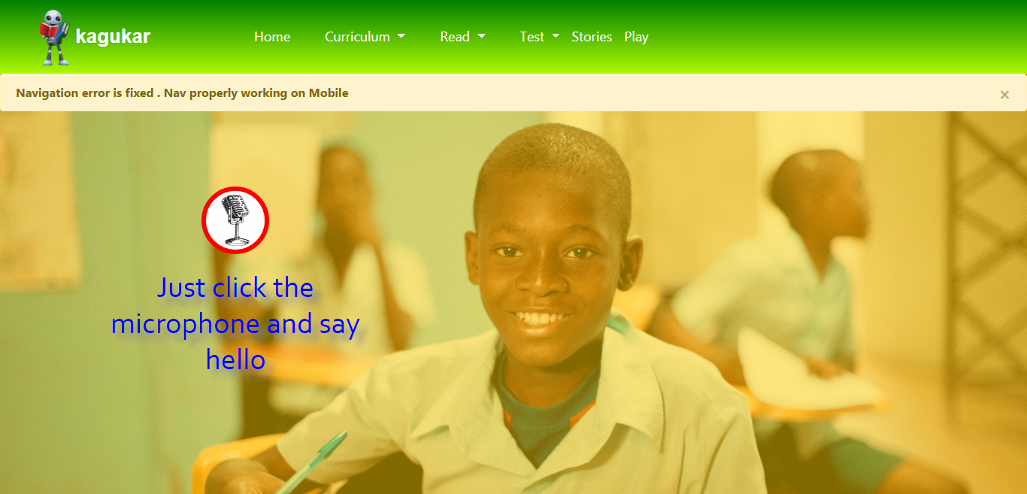
https://kagukar.netlify.app

Slide 3
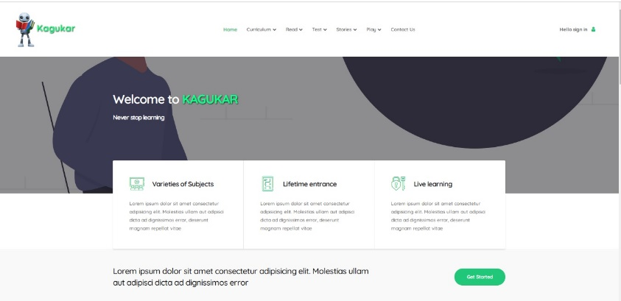
https://salty-oasis-64205.herokuapp.com

Slide 4
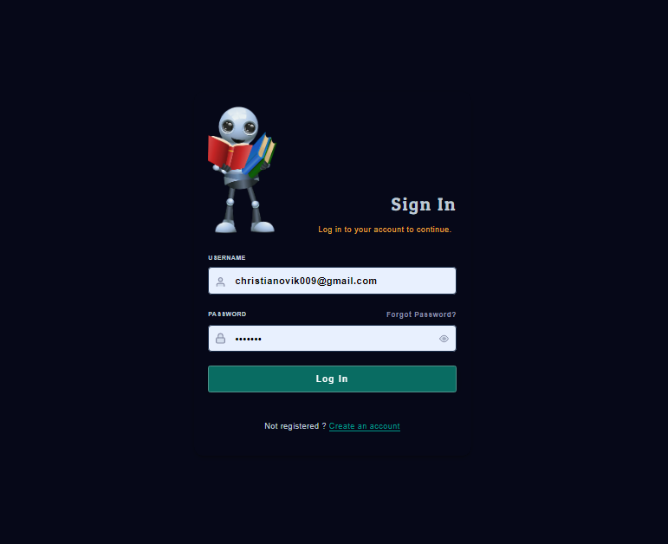
https://salty-oasis-64205.herokuapp.com/api/auth

Slide 5
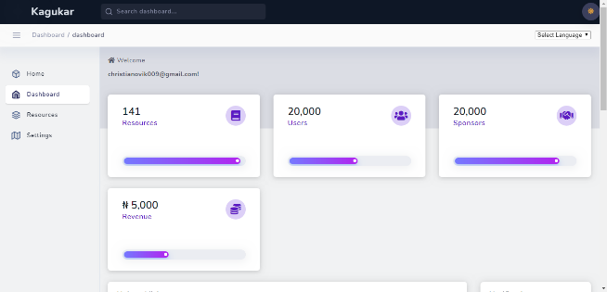
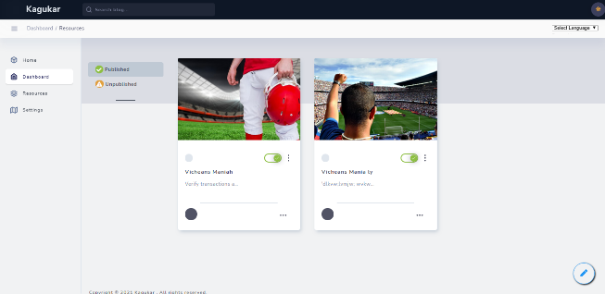
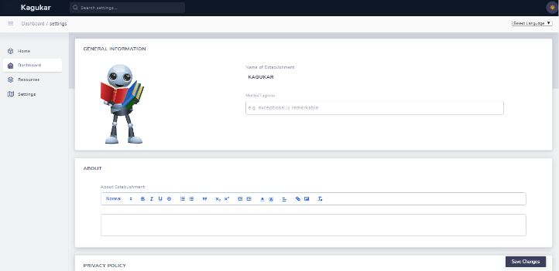
…/admin/dashboard
…/dashboard/contents
…/admin/dashboard/settings

Slide 6
Thank You!

